Slide 1
Resource pack for immunisers: Identification of poliovirus in London sewage samples
Immunisation and Vaccine Preventable Diseases Division

Slide 2
Identification of poliovirus in London sewage samples – background
Press Notice published on 22/06/2022: Poliovirus detected in sewage from North and East London - GOV.UK (www.gov.uk)
UKHSA public health message cascaded via the CAS system – letter for health professionals: https://www.gov.uk/government/publications/polio-detection-of-vdpv2-in-london-sewage-samples
You can find a brief explainer video here: https://youtu.be/L19rc7vdYVA
Particular actions for primary care colleagues and immunisers to focus on are:
  the need to catch up children under 5 years who are not up to date with their routine vaccinations. This is particularly important in practices and local authorities where vaccine coverage for the primary DTaP/IPV/Hib/HepB course is below 85%
  the importance of checking newly registered children and adults are up to date with the UK schedule, especially new migrants, asylum seekers and refugee
  Quarterly COVER data - vaccine coverage for routine programme in children aged 1 , 2 and 5 years can be found here (Source: UKHSA): Vaccine uptake guidance and the latest coverage data - GOV.UK (www.gov.uk)
  Td/IPV vaccine coverage data for 2020/21 academic year (Source: UKHSA): School leaver booster (Td/IPV): vaccine coverage estimates - GOV.UK (www.gov.uk)

Slide 3
UK polio vaccination schedule
Polio vaccine is part of the NHS routine childhood vaccination schedule.
It's given to babies and children when they are:
8, 12 and 16 weeks old as part of the 6-in-1 vaccine (DTaP/IPV/Hib/HepB)
3 years and 4 months old as part of the 4-in-1 pre-school booster (DTaP/IPV)
14 years old as part of the 3-in-1 teenage booster (Td/IPV)
You need to have all of these vaccinations to be fully vaccinated against polio.
If you have missed out for any reason, you can have polio vaccination for free on the NHS at any age.
You should get vaccinated even if you've had polio before as the vaccine protects against different types of polio.

Slide 4
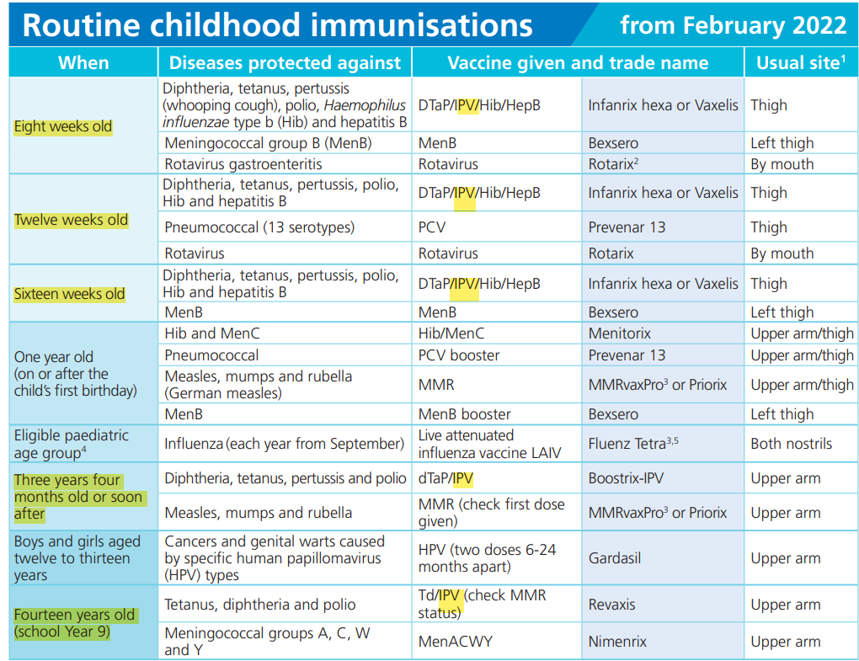

Slide 5

Checking for polio vaccination in the red book
Since 2004, all polio vaccines have been given as combined products, so you may not see the word polio in the record. The vaccinations can be labelled as any of the following.
Babies
Primary course of polio vaccine consists of three doses
given at 8, 12 and 16 weeks of age:
6-in-1 DTaP/IPV/Hib/HepB [used since September 2017]
OR
5-in-1 DTaP/IPV/Hib [used prior to Septemebr 2017]
Pre-school booster at 3 years and 4 months:
4-in-1 DTaP/IPV
Teenage booster given in School Year 9 or 10, at around 14 years of age:
3-in-1 Td/IPV
Toddlers
There is also an ELECTRONIC red book: eRedbook - The Digital Red Book For Parents
Teenagers
If you were vaccinated before 2004, you will have received the oral polio vaccine (OPV) which was given as drops in the mouth, rather than an injection.

Slide 6
Advice for health professionals: polio, uncertain or incomplete immunisation schedule
Please follow algorithm for: Vaccination of individuals with uncertain or incomplete immunisation status (publishing.service.gov.uk)
Children aged from 2 months of age up to 3 years and 4 months | Children from 3 years and 4 months up to 10th birthday | From 10th birthday onwards
Primary course: Three doses of DTaP/IPV/Hib/HepB with a our 4 week gap | Primary course: Three doses of DTaP/IPV/Hib/HepB with a our 4 week gap | Primary course: Three doses of Td/IPV with a 4 week gap
 | First booster of DTaP/IPV can be given as early as 1 year following completion of primary course to re-establish on routine schedule. Additional doses of DTaP-containing vaccines given under 3 years of age in some other countries do not count as a booster to the primary course in the UK and should be discounted. | First booster of Td/IPV: Preferably 5 years following completion of primary course Second booster of Td/IPV: Ideally 10 years (minimum 5 years) following first booster
Patients should be brought up to date with ALL vaccines they are eligible for according to age at the earliest opportunity

Slide 7
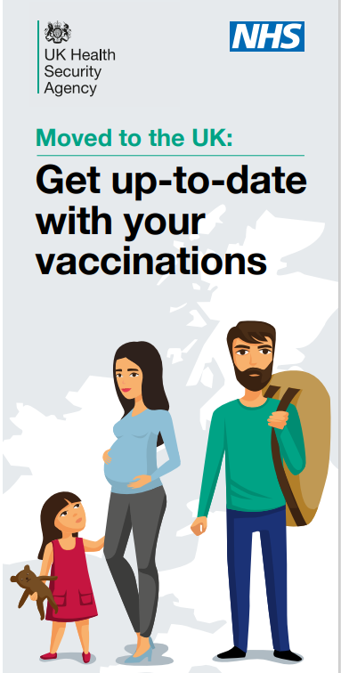
Useful resources:
NHS webpages:
  Polio - NHS (www.nhs.uk)
  NHS vaccinations and when to have them
  6-in-1 vaccine
Complete routine immunisation schedule: Complete routine immunisation schedule - GOV.UK (www.gov.uk)
Vaccination of individuals with uncertain or incomplete immunisation status (publishing.service.gov.uk)
Migrant health guide immunisation section: Immunisation: migrant health guide - GOV.UK (www.gov.uk)
Immunisation information for migrants: Immunisation information for migrants - GOV.UK (www.gov.uk)
UK and international immunisation schedules comparison tool: UK and international immunisation schedules comparison tool - GOV.UK (www.gov.uk)

Slide 8
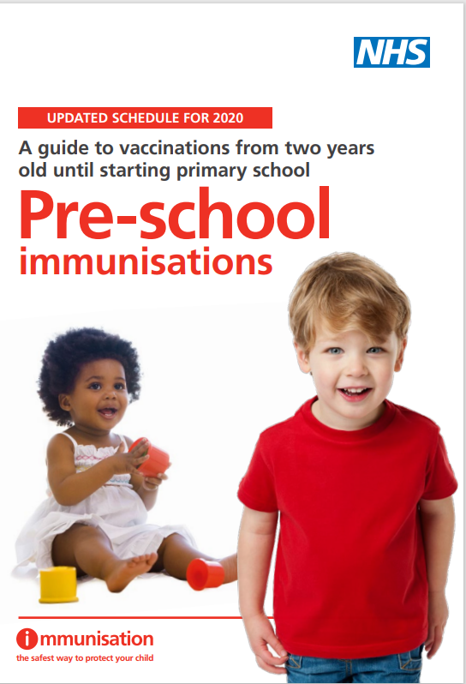
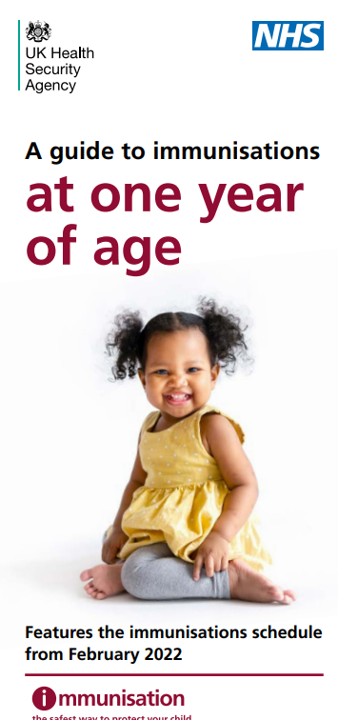
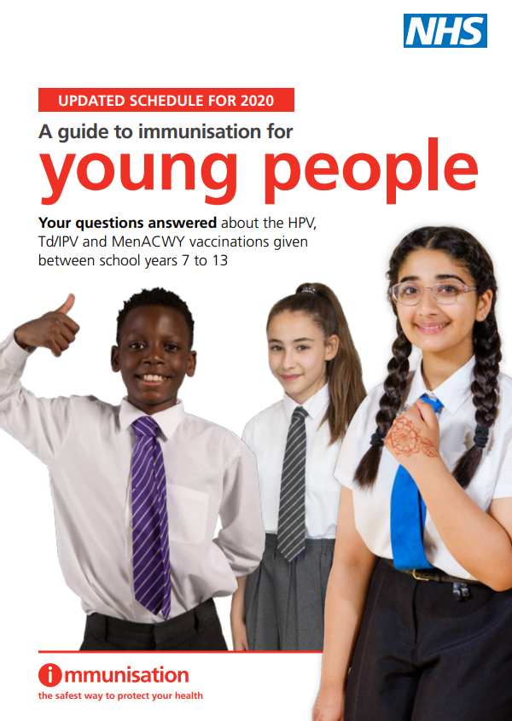
Leaflets for parents / carers
Copies of these leaflets are available free to order from the Health Publications order line 0300 123 1002 or Home - Health Publications
Primary course Immunisations at one year of age - GOV.UK (www.gov.uk) Product code 2022QG1EN
Pre-school booster Pre-school vaccinations: guide to vaccinations from 2 to 5 years - GOV.UK (www.gov.uk) Product code 3197560P
Teenage booster Immunisations for young people - GOV.UK (www.gov.uk) Product code 2902598B

Slide 9
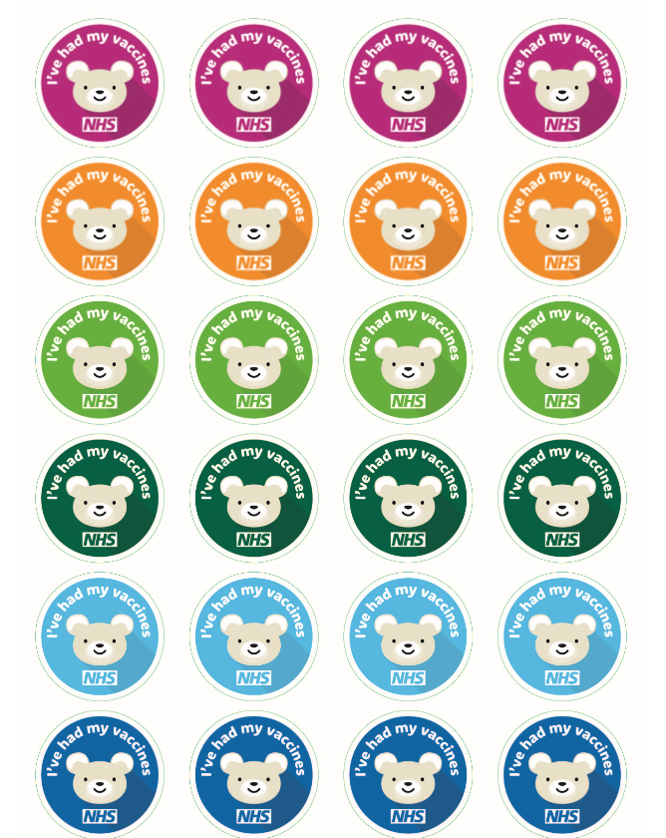
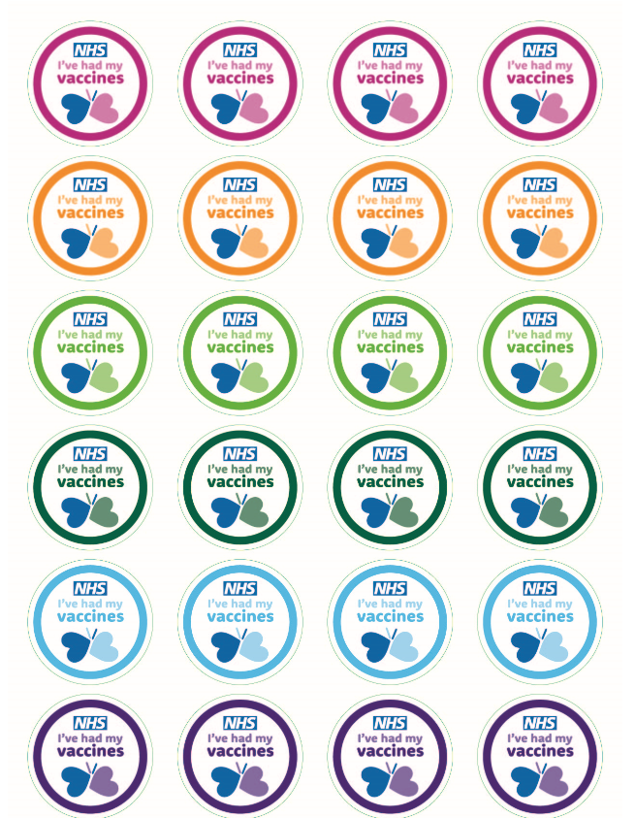
Immunisation stickers – order for free
Immunisation stickers bear design: https://www.healthpublications.gov.uk/ViewArticle.html?sp=Simmunisationstickers5yearstoadultbeardesign
Immunisation stickers butterfly design: https://www.healthpublications.gov.uk/ViewArticle.html?sp=Simmunisationstickers5yearstoadultbutterflydesign

Slide 10
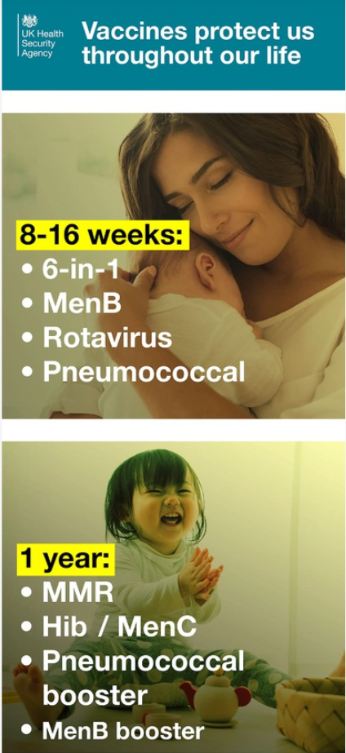
Social media assets
Social media routine immunisation schedule https://publichealthengland-immunisati.box.com/s/cv3yhtkxxqufovgc8ke4l0ytlkzfb25y
Three animations to promote immunisation to 0 to 1, 1-2, 0 to 5 years https://publichealthengland-immunisati.box.com/s/2gd8iif6eu8w9djwkkxfli4vm969luer
Measles mumps and rubella teenage social banners https://publichealthengland-immunisati.box.com/s/rhrtl6io3fuimougtpe6zt2xj3ue8jdgTeenage
Banners for HPV, MenACWY and Teenage booster (for Tetanus, diphtheria and polio) https://publichealthengland-immunisati.box.com/s/4097xmmxvjbjcjobks4e14bbpuwfkpei
Teenage banners as above but square for Facebook/Meta https://publichealthengland-immunisati.box.com/s/t6a15kb84zib64wqebsnvomdjjul27ok
Teenage social – missed your teenage booster, MMR, MenACWY Call to action https://www.healthpublications.gov.uk/ViewArticle.html?sp=Sroutinevaccinationsforteenagersandyoungpeoplesocialmediacard

