Slide 1
Value of Vaccines
Let’s get everyone up to date with their routine vaccinations now!

Slide 2

Text should be 12-18pt Arial. Do not use other fonts.

Slide 3


Slide 4

7

Slide 5


Slide 6
Download these resources and use them to promote vaccination in your region
Go to https://bit.ly/2lxMzvP

Slide 7


Slide 8


Slide 9


Slide 10


Slide 11
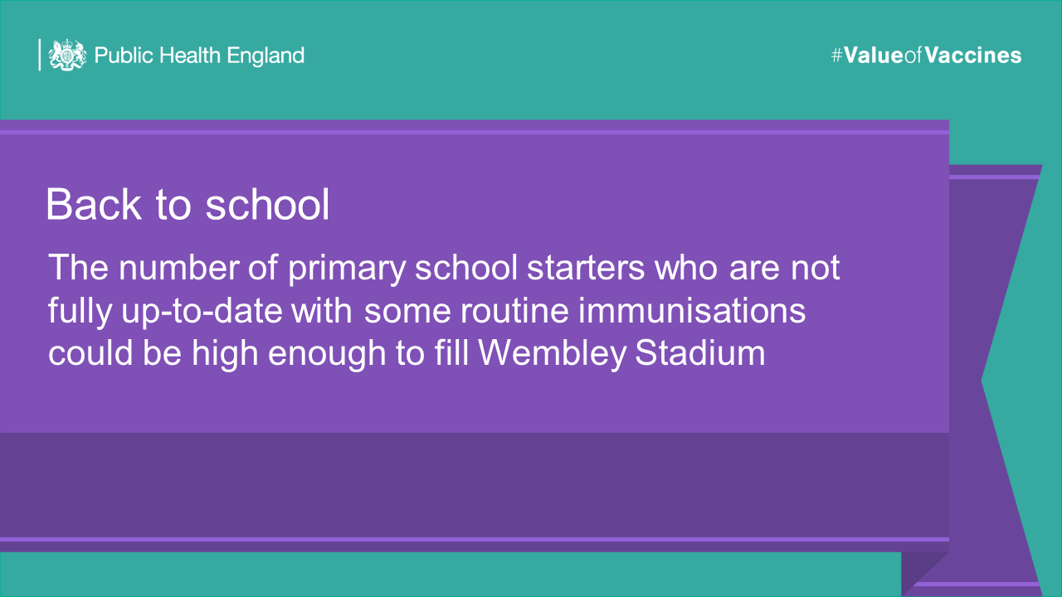

Slide 12


Slide 13
Follow us at @PHE_uk
#ValueofVaccines
Download:https://bit.ly/2lxMzvP

