Slide 1
Vaccination against shingles
(Herpes Zoster)
July 2023
Notes:
Background
In 2010, the Joint Committee on Vaccination and Immunisation (JCVI) was asked by the Secretary of State for Health to review the available evidence relevant to the introduction of a universal vaccination programme to protect against shingles (Herpes Zoster).
The JCVI considered a range of issues including disease epidemiology, vaccine efficacy, vaccine safety and the cost effectiveness of introducing a routine shingles vaccination programme in the UK. Based on the findings of the cost-effectiveness analysis, the JCVI recommended a universal routine herpes zoster (shingles) vaccination programme using a single dose of the live Zostavax shingles vaccine for adults aged 70 with a catch-up programme for those aged 71 to 79 years. Individuals who reached their 80th birthday were not eligible for a shingles vaccination due to the reduced efficacy of Zostavax vaccine with increased age.
From September 2013, a single dose of Zostavax shingles vaccine was offered routinely to individuals aged 70 years (born on or after 1 September 1942) with a phased catch up programme based on age as of 1 September that year. From August 2021 Shingrix vaccine was introduced as an alternative vaccine for immunocompromised individuals.
From September 2023 Shingrix will be offered to all severely immunosuppressed individuals from 50 years of age and to immunocompetent individuals from 60 years of age over a 10 year phased introduction.
This resource is designed to support healthcare practitioners involved in discussing routine vaccination against shingles. This resource does not cover vaccine administration techniques; practical training and competency assessment should be provided locally for new or returning immunisers.
Shingles is also known as herpes zoster. Shingles is the term used throughout this slide set.

Slide 2
Learning outcomes
After completing this training, immunisers will be able to:
describe the aetiology and epidemiology of shingles
describe the relationship between shingles and chickenpox (varicella zoster) and the severity of shingles disease in the older population
discuss the important role of vaccination against shingles
describe the changes to the national shingles vaccination programme from 1 September 2023
identify sources of additional information
Notes:
Content
Shingles infection
Epidemiology
Shingles vaccine
National shingles vaccination programme
Resources

Slide 3
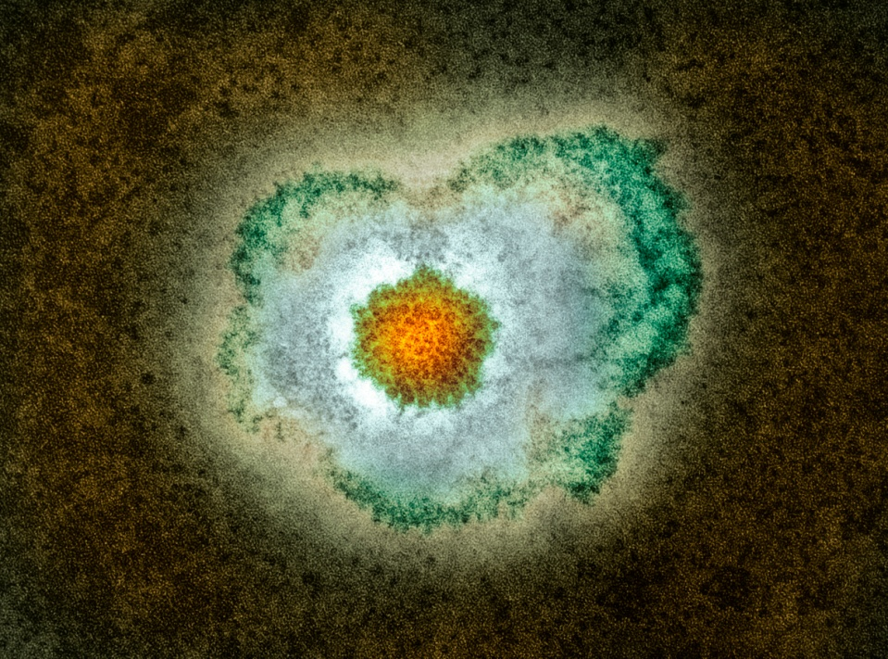
Shingles infection
shingles is a viral infection of the nerve cells and surrounding skin
after a person recovers from chickenpox infection (caused by the varicella zoster virus), the virus remains dormant in the nerve cells and can reactivate at a later stage when the immune system is weakened
reactivation of the dormant virus leads to the clinical manifestation of shingles
reactivation can be associated with older age, malignancy, immunosuppressant therapy or HIV infection
Image courtesy of UKHSA/SPL
Notes:
Shingles (herpes zoster) is caused by the reactivation of a latent varicella zoster virus (VZV) infection, generally decades after the primary infection
Following primary VZV infection, the virus enters the sensory nerves and travels along the nerve to the sensory dorsal root ganglia and establishes a permanent latent infection
Increasing incidence of shingles infection among older age groups is thought to be associated with a decline in cell mediated immunity to varicella zoster virus (i)
Although rare, it is possible to have shingles more than once
Shingles is not caused by the same virus that causes genital herpes
Green Book Chapter 1:
Immunity and how vaccines work: the green book, chapter 1 - GOV.UK (www.gov.uk)

Slide 4
Clinical presentation of shingles
Prodromal phase – the first signs of shingles may include:
abnormal skin sensations and pain in the affected area of skin
headache
feeling generally unwell
photophobia
malaise
fever (although this is less common)
A prodromal illness is experienced by 80% of individuals with shingles and can begin up to 72 hours before the rash appears
Notes:
Shingles images are available on the NHS website: https://www.nhs.uk/conditions/shingles/

Slide 5
Clinical presentation of shingles (2)
Acute stage
a rash of fluid filled blisters develops after a few days, commonly on one side of the face or body, usually within the distribution of a dermatome (an area of skin that is supplied by a single nerve)
the rash often causes intense pain, burning, tingling, itching or numbness in the area of the affected nerve
the rash forms blisters that typically scab over in 7 to 10 days and eventually clears within 2 to 4 weeks
in individuals with a weakened immune system, a more disseminated rash covering multiple dermatomes may occur and this may appear similar to the chickenpox rash
Notes:
Shingles can affect any part of the body, although most commonly affected areas include face (including eyes) chest and abdomen.
Individuals may also experience pain in the arms and legs and may feel exhausted.
A dermatome can be defined as an area of skin that is supplied by a single nerve. Shingles can affect one or more isolated dermatomes.

Slide 6
Possible complications of shingles
Shingles is more likely in adults 50 years of age and over, with the severity of the illness increasing with age
Most common complications are:
post herpetic neuralgia (PHN)
secondary bacterial skin infections
Less common complications can include:
ophthalmic zoster (leading to keratitis, corneal ulceration, conjunctivitis, retinitis, optic neuritis and or glaucoma)
peripheral motor neuropathy
In severe cases, shingles can lead to hospitalisation and death
Notes:
Shingles can cause a number of secondary complications and the severity of these can be dependent on how weak the individual’s immune system is.
Most commonly reported complications in the older age groups include secondary bacterial infections at the site of the rash (that may require antibiotic therapy) and post herpetic neuralgia.
Other less common complications can include ophthalmic shingles and peripheral motor neuropathy. Ophthalmic shingles affects the facial nerve (trigeminal) and can cause ulceration and scarring of the eye and uveitis (inflammation of the inner eye). Ophthalmic shingles can also cause loss of vision if untreated and is often associated with long term pain. Estimates show between 10 and 20% of shingles cases result in ophthalmic zoster with approximately 4% of these cases resulting in long term sequelae
Peripheral motor neuropathy is more common in the elderly population and results in temporary nerve damage to a peripheral motor nerve that controls movement of a limb, such as the arm or leg, causing paralysis in that limb. This effect is temporary and individuals can make a good recovery.
Disseminated disease is more likely to occur in those who are severely immunosuppressed, most deaths being attributable to pneumonia.

Slide 7
Post Herpetic Neuralgia (PHN)
Post herpetic neuralgia (PHN) is a common complication of shingles in older adults:
PHN is pain at the rash site that persists for, or appears more than 90 days after the onset of the shingles rash
on average PHN lasts from 3 to 6 months, but can persist for longer
severity of pain may be constant, intermittent or triggered by stimulation of the affected area, such as a breeze on the face
the pain may be described as burning, itching, stabbing or aching; the site may be extremely sensitive to touch; it is not generally relieved by common painkillers
PHN is more likely to develop, and is more severe, in people over the age of 50, with one third of sufferers over the age of 80 experiencing intense pain
Notes:
PHN is defined as an intense pain that persists for, or develops after 90 days following the onset of the shingles rash and can persist for between 3 and 6 months in 50% of those affected. This pain can last longer and is dependent on the individual’s immune system.
As the pain can be intense and is not generally relieved by common pain killers, PHN can have a negative impact on the individual’s quality of life. PHN can contribute to fatigue, insomnia, depression, anxiety and can impair the basic activities of daily living for the individual.

Slide 8
Infectious period
a person with shingles is only infectious when the rash is present and fluid filled vesicles are present
a person is not infectious before the rash is present or when the rash has crusted
Shingles is less infectious than chickenpox and covering the rash will greatly reduce the risk of exposure to those non-immune to chickenpox

Slide 9
Transmission
the varicella virus that causes shingles (herpes zoster) is the same virus that causes chickenpox (varicella zoster)
unlike chickenpox, shingles is not spread through coughing, sneezing or casual contact
shingles cannot be transmitted from one person to another
a person exposed to shingles will not develop shingles
a person exposed to chickenpox will not develop shingles
however, a person who has not had chickenpox may develop chickenpox as a result of exposure to the herpes zoster virus through direct contact with the fluid filled blisters from someone who has shingles
Notes:
Infection with varicella zoster (chickenpox) is a pre-requisite for the development of shingles
You do not develop shingles from being in contact with chickenpox
Shingles cannot be transmitted from one person to another, although it can cause chickenpox in individuals who have not previously had the disease and who have direct contact with the fluid from the shingles vesicles

Slide 10
Incidence of shingles
Prior to the introduction of the shingles vaccine:
over 50,000 cases of shingles occurred in people aged 70 years and over each year in England and Wales
of these,14,000 developed post herpetic neuralgia (PHN)
1,400 cases of shingles resulted in hospitalisation
one in 1,000 cases of shingles in people 70 years of age and over are estimated to result in death*
the risk of shingles is increased in individuals with certain conditions, including systemic lupus erythematosus, rheumatoid arthritis, diabetes and Wegener’s granulomatosis
* due to the nature of the population and risk of co-morbidities some deaths recorded as being shingles-related may not be directly attributable to the disease
Notes:
Data from GP-based studies in England and Wales; Green Book Shingles Chapter 28a

Slide 11
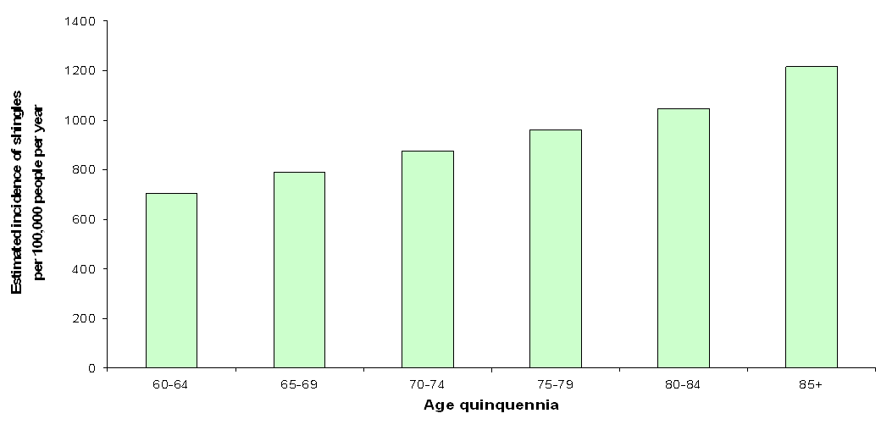
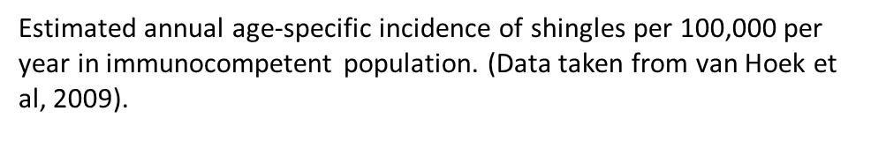
Epidemiology of shingles in England and Wales
Notes:
The above graph shows the estimated annual age-specific incidence of shingles per 100, 000 per year in the immunocompetent population (Y-axis) against the age quinquennia (X-axis).
(Quinquennia = 5 year divisions)
The graph shows a continued increase in cases of shingles with advancing age, confirming that the incidence of shingles is largely associated with older age and that older individuals are more at risk of developing the disease.
Age-specific incidence rates of shingles have been estimated using a number of different primary care derived data sources including: the Royal College of General Practitioners (RCGP) Weekly Returns Service; the fourth Morbidity Survey in General Practice (MSGP-4), and the General Practice Research Database.
These are estimates (based on available data sources) as shingles is only clinically diagnosed, thus no lab confirmation of this is available. Actual figures may be much higher.

Slide 12
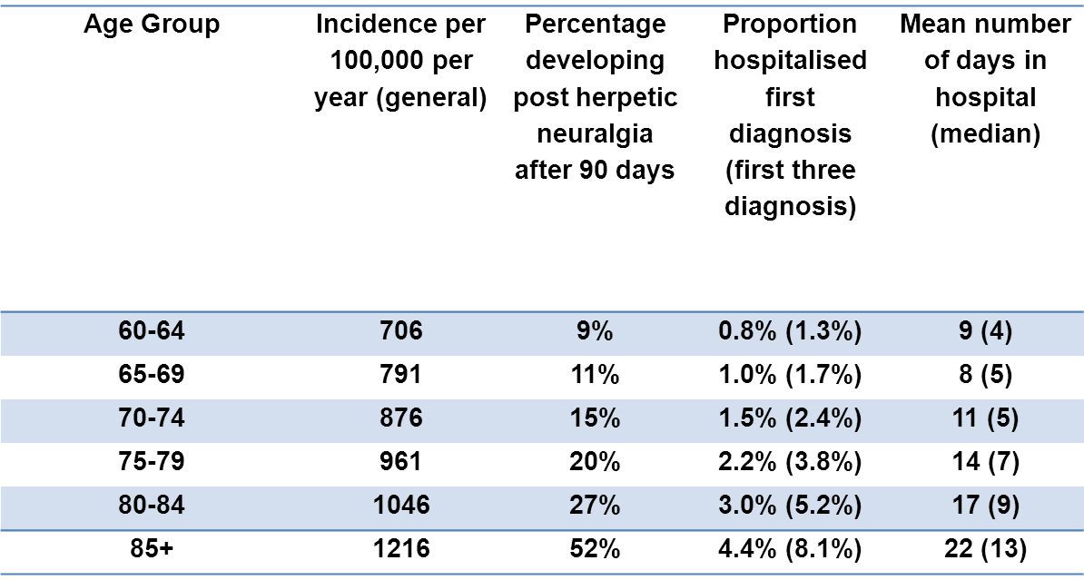
Epidemiology of shingles in England and Wales
Estimated annual age-specific incidence, hospitalisation rate, length of inpatient stay, Burden of disease in the immunocompetent population England and Wales. (Data taken from van Hoek and others, 2009)
Notes:
This table again shows the estimated annual age specific incidence per 100,000 with the associated burden of disease for each of the age quinquennia.
The burden of disease is measured in this table as the percentage developing post herpetic neuralgia (PHN) after 90 days, proportion of those hospitalised after the first diagnosis and the mean number of days spent in hospital.
The table shows the association between the incidence of age related shingles and the burden of disease. In particular, those individuals above 75 years of age account for a higher percentage of those developing PHN after 90 days. They are more likely to be hospitalised as a result of the disease and stay the longest when admitted to hospital.
As shown in the table, the burden of disease is closely related to age with those in the older age groups experiencing severe forms of the illness.
The severity of the disease burden is markedly increased in those individuals aged 75 to 85+ years. Individuals aged 85 years and over account for 4.4% of hospital admissions after the first diagnosis and 8.1% of hospital admissions within the first 3 diagnoses. They account for 52% of individuals developing PHN after 90 days and as a result of the disease, require a minimum of 22 days in hospital. This highlights the severity and impact of the disease in this age group and emphasises the importance of offering vaccination to older individuals.

Slide 13
Shingles vaccine coverage data: England
shingles vaccination was successfully introduced in England during September 2013
however, since then, there has been a year on year decline in vaccine uptake (coverage) in the routine (70-year-old) cohort
* different methodology and eligibility criteria was adopted from this year onwards
Notes:
Shingles vaccine coverage report (adults eligible from April 2021 to March 2022 and vaccinated to June 2022) – England:
https://www.gov.uk/government/publications/herpes-zoster-shingles-immunisation-programme-2021-to-2022-evaluation-reports
Shingles vaccine is available through GP surgeries in primary care and GPs are required to identify and put in place a call/recall arrangement to offer the shingles vaccination to eligible patients. Shingles vaccine can be offered throughout the year.

Slide 14
Evaluation of the shingles vaccination programme
Large and sustained reductions in herpes zoster and PHN consultations and hospitalisations were observed in the first 5 years of the routine shingles programme in England when the live Zostavax vaccine was used.
Due to the vaccination programme, there were an estimated:
40,500 fewer herpes zoster GP consultations
1,840 fewer herpes zoster hospitalisations including 540 PHN consultations
These reductions were consistent with a vaccine effectiveness of:
between 37% (for hospitalised zoster) and 75% (for PHN consultations) in the routine cohorts (vaccinated aged 70)
between 49% (for hospitalised PHN) and 66% (for PHN consultations) in catch up cohorts (vaccinated aged 78 to 79)
Andrews N et al. Impact of the herpes zoster vaccination programme on hospitalised and general practice consulted herpes zoster in the 5 years after its introduction in England: a population-based study. BMJ Open 2020;10:e037458
Notes:
https://bmjopen.bmj.com/content/bmjopen/10/7/e037458.full.pdf
Impact of the herpes zoster vaccination programme on hospitalised and general practice consulted herpes zoster in the 5 years after its introduction in England: a population-based study
Andrews N, Stowe J, Kuyumdzhieva G, Sile B, Yonova I, de Lusignan S, Ramsay M, Amirthalingam G
e037458.full.pdf (bmj.com)

Slide 15
Shingles vaccines
There are currently 2 shingles vaccines available in England:
Zostavax: – live attenuated vaccine
– one dose
Shingrix: – recombinant adjuvanted subunit vaccine (non-live)
– 2 doses with a minimum of 8 weeks between the 2 doses
severely immunosuppressed individuals: 8 weeks to 6 months between doses
immunocompetent individuals: 6 months to 12 months between doses
As Zostavax is being phased out, stock will only be available until current supply, available to order from ImmForm, is used up.

Slide 16
Changes to the shingles vaccination programme from 1 September 2023
in February 2019, based on impact and cost effectiveness modelling, the JCVI recommended that the national shingles immunisation programme be changed such that Shingrix is offered
  routinely at 60 years of age
  to immunocompromised individuals aged 50 years and over
JCVI also advised a catch-up of 60 to 70 year olds that should be implemented in stages, starting with vaccination of those turning 65 and 70 years, then moving to vaccination of those turning 60 and 65 years, following which time vaccination could then be routinely offered to those turning 60 years of age
the advice was based on the high efficacy, safety, and immunogenicity of Shingrix observed in clinical trials
evidence suggests that Shingrix provides a substantially longer duration of protection from shingles than Zostavax
there is now sufficient supply of Shingrix to implement the JCVI recommendations
the changes to the programme should be implemented from 1 September 2023

Slide 17
Key points about the changes to the programme (1) Change of vaccine
Shingrix will replace Zostavax for the whole shingles programme
Shingrix will require a 2-dose schedule for all cohorts, but the dosing interval will differ for severely immunosuppressed and immunocompetent patients
individuals who have received Zostavax previously should not be revaccinated with Shingrix
Shingrix should be offered to all people reaching the eligible age on or after 1 September 2023
shingles vaccination should continue to be offered year-round: patients can be immunised with shingles vaccine at any point in the year as soon as they reach eligible age
those cohorts previously eligible for Zostavax who are under 80 years of age should continue to be offered Zostavax until central stocks (ordered via ImmForm) deplete, after which they should be offered Shingrix
Shingrix can be administered at the same time as, or at any interval from, other vaccines including influenza vaccines and the 23-valent pneumococcal polysaccharide vaccine (PPV23)

Slide 18
Key points about the changes to the programme (2) Changes to eligibility: severely immunosuppressed
Severely immunosuppressed cohort
since September 2021, Shingrix has been available to immunocompromised individuals aged 70 to 79 years, who are contraindicated to receive Zostavax
the forthcoming change from 1 September 2023 will expand the eligibility to all severely immunosuppressed individuals (eligibility as defined in the Green Book Shingles Chapter 28a) aged 50 years and over (with no upper age limit)
severely immunosuppressed individuals who have already received 2 doses of Shingrix do not need to receive re-vaccination or additional doses
severely immunosuppressed individuals represent the highest priority for vaccination given their risk of severe disease, and therefore the programme aims to catch up all severely immunosuppressed individuals aged 50 years and over in the first year of the programme implementation
the second dose of Shingrix should be given 8 weeks to 6 months after the first dose for this cohort
Notes:
There should be a minimal interval between the 2 doses of Shingrix vaccine of 8 weeks.

Slide 19
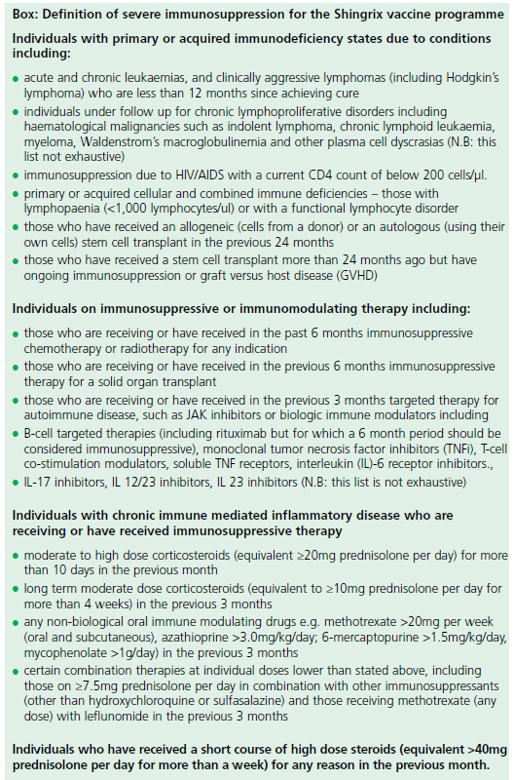
Green Book: Definition of severe immunosuppression
For details about which individuals with severe immunosuppression should be offered Shingrix vaccine from 50 years of age, vaccinators should refer to the box in the Green Book Shingles Chapter 28a.
If there is any doubt, individual patients should be discussed with their specialist.
Box from Green Book Chapter 28a Shingles (herpes zoster)

Slide 20
Key points about the changes to the programme (3) Changes to eligibility: immunocompetent cohort
The eligible age for immunocompetent individuals will change from 70 to 60 years of age for the routine cohort, in a phased implementation over a 10 year period in two 5-year stages:
Stage 1 (1 September 2023 to 31 August 2028)
  Shingrix will be offered to those turning 70 and 65 years on or after 1 September 2023
  anyone aged 65 to 69 before 1 September 2023 will not be eligible for shingles vaccination until they turn 70 years of age
  Zostavax will be offered to individuals aged between 70 to 79 that were eligible for the vaccination programme before 1 September 2023. Once all stocks of Zostavax are exhausted, these individuals can be offered Shingrix if they have not previously been given a shingles vaccine
Stage 2 (1 September 2028 to 31 August 2033)
  Shingrix will be offered to those turning 65 and 60 years of age
All immunocompetent individuals remain eligible for shingles vaccine until their 80th birthday.
The second dose of Shingrix should be given 6 to 12 months after the first dose for this cohort.
Where an individual has turned 80 years of age following their first dose of Shingrix, a second dose should be provided before the individual’s 81st birthday to complete the course.
From 1 September 2033 and thereafter, Shingrix will be offered routinely at age 60 years.
Notes:
Those that become eligible but do not take up the vaccine offer immediately remain eligible until their 80th birthday.
Individuals who were eligible for Zostavax should continue to receive Zostavax until central stocks are depleted, after which time they should receive Shingrix.
The 80th birthday upper age cut off remains in place for the immunocompetent cohort regardless of vaccine offered.
Recommended scheduling for immunocompetent individuals is to give the second dose 6 to 12 months after the first dose.

Slide 21
Implementation stages for Shingrix vaccine for immunocompetent individuals from 1 September 2023
Implementation stages | Delivery period | Eligible for first dose
Stage 1 (5 year duration) | 1 Sept 2023 to 31 Aug 2028 | Those who reach age 65 or 70 years during this period should be called in on or after their 65th or 70th birthday
Stage 2 (5 year duration) | 1 Sept 2028 to 31 Aug 2033 | Those who reach age 60 or 65 years during this period should be called in on or after their 60th or 65th birthday
Ongoing routine offer | 1 Sept 2033 onwards | Those turning 60 years of age should be called in on or after their 60th birthday

Slide 22
Zostavax vaccine
Zostavax
Shingles (herpes zoster) vaccine (Live)
Merck Sharp & Dohme MSD
live attenuated (weakened live organism)
1 dose schedule
recommended for immunocompetent individuals 70 to 79 years of age already eligible for the routine immunisation schedule
Zostavax should continue to be offered to this cohort until supply of national stock has been depleted; once this has happened Shingrix will be offered instead
Notes:
The aim of the national shingles immunisation programme is to lower the incidence and severity of shingles in the older population.
From September 2023 Zostavax vaccine will eventually be replaced with Shingrix for everyone following the agreed implementation plan. Zostavax should continue to be offered to immunocompetent individuals until stocks from ImmForm are exhausted.

Slide 23
Zostavax vaccine efficacy
In clinical trials, a one-dose schedule of Zostavax was assessed in 17,775 adults aged 70 years and over.
The incidence of shingles was reduced by 38% and provided protection for at least 5 years.
For those vaccinated but who later developed shingles:
  the burden of illness was significantly reduced by 55%
  the incidence of PHN was significantly reduced by 66.8%
Notes:
In a clinical trial, one dose of Zostavax was assessed in 38,546 adults aged 60 years and over of whom 17,775 were aged 70 years or over.
The Zostavax vaccine reduced the incidence of shingles in those aged 70 years and over by 38%⁷, and the incidence of PHN by 66.8%.

Slide 24


Zostavax composition
Composition
Varicella-zoster virus, Oka/Merck strain (live, attenuated) not less than 19400 PFU*
produced in human diploid (MRC-5) cells
* PFU = Plaque-forming units
Excipients
Powder:
Sucrose
Hydrolysed gelatin
Sodium chloride
Potassium dihydrogen phosphate
Potassium chloride
Monosodium L-glutamate monohydrate
Disodium phosphate
Sodium hydroxide (to adjust pH)
Urea
Solvent:
Water for injection
Residual substances
This vaccine may contain traces of neomycin
Notes:
https://www.medicines.org.uk/emc/product/6101

Slide 25
Zostavax contraindications
Contraindications to Zostavax:
confirmed anaphylactic reaction to a previous dose of varicella-containing vaccine or any component of the vaccine
pregnancy (Zostavax is not indicated in women of childbearing age and women who are pregnant should not receive Zostavax)
immunosuppression due to underlying condition or treatment as defined in the Green Book Shingles Chapter 28a
Notes:
Green Book Chapter 28a Shingles
https://www.gov.uk/government/publications/shingles-herpes-zoster-the-green-book-chapter-28a
From 1 September 2023 Shingrix vaccine is available for all severely immunosuppressed individuals from 50 years of age (eligibility as defined in the Green Book Shingles Chapter 28a)

Slide 26
Zostavax cautions
individuals who are acutely unwell should postpone immunisation until they have recovered
some individuals in an age-eligible cohort who are less severely immunosuppressed may be able to receive Zostavax; a clinical risk assessment for suitability should first be carried out
individuals under highly specialist care would need full review of their treatment and clinical history; vaccination with Zostavax should not proceed until the advice of the treating specialist or an immunologist has been sought
primary healthcare professionals with concerns about the nature of their patient’s prescribed therapies or their degree of immunosuppression, should contact the relevant specialist for advice about shingles vaccination
Notes:
As Zostavax is a live vaccine, it is essential to check that the recipient has no contraindications to receiving this vaccine.
If the individual is under highly specialist care, and it is not possible to obtain full information on that individual’s treatment history, then vaccination should not proceed until the advice of the specialist or a local immunologist has been sought.
Specialists with responsibility for patients in the vaccine eligible cohorts should include a statement of their opinion on the patient’s suitability for Zostavax in their correspondence with primary care. If primary healthcare professionals administering the vaccine have concerns about the nature of therapies or the degree of immunosuppression they should contact the relevant specialist for advice.
Shingrix vaccine is available for immunosuppressed individuals (full details available in the Green Book Shingles Chapter 28a)
From 1 September 2023 Shingrix vaccine is available for all severely immunosuppressed individuals from 50 years of age.
Individuals with milder immunosuppression (not listed in the Box: ‘definition of severe immunosuppression’ in the Green Book shingles Chapter 28a) are not eligible to receive Shingrix from age 50 and must wait until they reach the routine programme qualifying age or there is a change in their medical status.

Slide 27
Zostavax and HIV infection
The safety and efficacy of Zostavax have not been conclusively established in adults who are known to be infected with HIV with or without evidence of immunosuppression:
refer Green Book Shingles Chapter 28a
seek advice from patient’s specialist
individuals with CD4 counts of 200 cells/μl or higher can usually be offered Zostavax

Slide 28
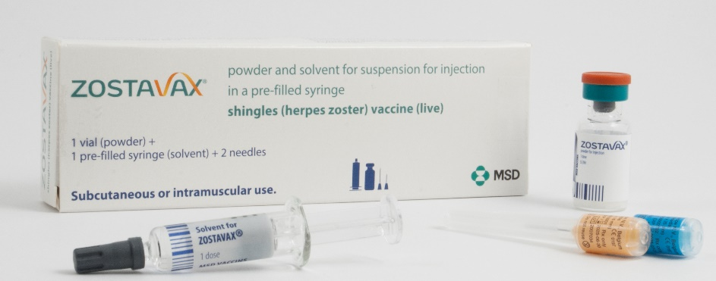
Zostavax presentation
Zostavax with solvent for reconstitution supplied in a
pre-filled syringe:
the powder in the glass vial is a white to off-white, compact crystalline plug
the diluent in the pre-filled syringe is a clear colourless liquid
when mixed together, Zostavax is a semi-hazy to translucent, off white to pale yellow liquid
Zostavax pack contains:
x1 Zostavax vial
x1 pre-filled syringe
x2 separate needles

Slide 29
Zostavax reconstitution instructions
separate needles should be used for the reconstitution and administration of the vaccine
to reconstitute the vaccine, inject the entire contents of the solvent syringe into the vial containing the powder
gently agitate to dissolve completely
withdraw the entire contents of the reconstituted vaccine into the syringe for injection
change the needle and push the new needle onto the extremity of the syringe and rotate a quarter of a turn (90⁰) to secure the connection
vaccine should be administered immediately after reconstitution
reconstituted vaccine should not be used if you notice any particulate matter or if the appearance of the solvent or of the reconstituted vaccine differs from that described in the SPC
Notes:
It is recommended that the vaccine be administered immediately after reconstitution. Discard reconstituted vaccine if it is not used within 30 minutes.
Zostavax is provided with 1 or 2 unattached needles in the pack (as sent from the manufacturer).
Vaccinators would need to supply their own green needle for reconstituting the vaccine and then select the most appropriate needle length for the patient.
For I/M injections the needle needs to be sufficiently long to ensure that the vaccine is injected into muscle, so longer length needles would be recommended for morbidly obese individuals.

Slide 30
Zostavax administration
a single dose of 0.65ml should be given by intramuscular injection, preferably in the deltoid region of the upper arm
intramuscular injection is the preferred route of administration as injection site reactions are significantly less frequent in those who receive the vaccine via this route
for individuals with a bleeding disorder, see advice in the PGD for full details
if more than one vaccine is given at the same appointment, give at separate sites, preferably in different limbs. If given in the same limb, they should be given at least 2.5cm apart
record the specific site each vaccine has been given in the individual’s records
Notes:
Individuals with bleeding disorders may be vaccinated intramuscularly if, in the opinion of a doctor familiar with the individual's bleeding risk, vaccines or similar small volume intramuscular injections can be administered with reasonable safety by this route. If the individual receives medication or treatment to reduce bleeding, for example treatment for haemophilia, intramuscular vaccination can be scheduled shortly after such medication or treatment is administered. Individuals on stable anticoagulation therapy, including individuals on warfarin who are up to date with their scheduled INR testing and whose latest INR was below the upper threshold of their therapeutic range, can receive intramuscular vaccination. A fine needle (equal to 23 gauge or finer calibre such as 25 gauge) should be used for the vaccination, followed by firm pressure applied to the site (without rubbing) for at least 2 minutes. If in any doubt, consult with the clinician responsible for prescribing or monitoring the individual’s anticoagulant therapy.
UKHSA PGD Templates: www.gov.uk/government/collections/immunisation-patient-group-direction-pgd
Zostavax: www.gov.uk/government/publications/shingles-vaccine-zostavax-patient-group-direction-pgd-template

Slide 31
Zostavax co-administration
Zostavax can be administered at the same time as inactivated vaccines such as influenza and 23-valent pneumococcal polysaccharide vaccine (PPV23)
Zostavax can be administered at the same time as, or before or after other live vaccines except MMR (Green Book Chapter 11 Table 11.3):
  – where MMR and Zostavax are not administered at the same time,
  a 4-week minimum interval should be observed between vaccines
Zostavax can be administered at the same time as all COVID-19 vaccines
Zostavax should not be administered to patients currently receiving oral or intravenous antivirals such as acyclovir or who are within 48 hours after cessation of treatment as the therapy may reduce the response to the vaccine
Notes:
See Green Book shingles chapter for more detail about co-administration of shingles vaccines with other vaccines.
For eligible immunocompromised individuals (details available in the Green Book Shingles chapter 28a), and where Zostavax is contraindicated, Shingrix vaccine is available for use.

Slide 32
Transmission of vaccine virus
Transmission of vaccine virus following Zostavax vaccination may occur rarely between recently vaccinated individuals who develop a varicella-like rash and susceptible contacts:
any person who develops a vesicular rash after receiving Zostavax should ensure the rash area is kept covered when in contact with a susceptible (chickenpox naïve) person until the rash is dry and crusted
prophylactic acyclovir can be considered in vulnerable patients exposed to a varicella-like rash in a recent vaccinee
if a varicella (widespread) or shingles-like (dermatomal) rash develops post-Zostavax, a vesicle fluid sample should also be sent for analysis to determine whether the rash is vaccine associated or wild type
Notes:
Post-marketing experience with varicella vaccines suggests that transmission of vaccine virus may occur rarely between those vaccinated who develop a varicella-like rash and susceptible contacts, although there has been no evidence of transmission of vaccine virus between vaccinees and susceptible contacts in the pre-licensure clinical trials of Zostavax.
As a precautionary measure, any person who develops a vesicular rash after receiving Zostavax should ensure the rash area is kept covered when in contact with a susceptible (chickenpox naïve) person until the rash is dry and crusted. If the person who received the vaccine is themselves immunosuppressed, they should avoid contact with susceptible people until the rash is dry and crusted, due to the higher risk of virus shedding. Prophylactic acyclovir can be considered in vulnerable patients exposed to a varicella like rash in a recent vaccinee.
Testing of post-vaccination rashes
In the event of a person developing a varicella (widespread) or shingles-like (dermatomal) rash post-Zostavax, a vesicle fluid sample should also be sent for analysis to confirm the diagnosis and determine whether the rash is vaccine associated or wild type. This service is available at the Virus Reference Department (VRD) at UKHSA, Colindale.
Transmission of vaccine virus from varicella vaccine recipients without VZV-like rash has not been confirmed. Whilst there remains a theoretical risk, therefore, in those who develop a rash following zoster vaccination of transmitting the attenuated vaccine virus to a susceptible individual , this risk should be weighed against the reduced risk of developing natural shingles and the much higher risk of transmission from the circulating wild type VZV in the community.

Slide 33
Zostavax possible adverse reactions
Most commonly reported (1:10 of people vaccinated)
Pain, redness, tenderness, pruritus, swelling at the injection site
Less commonly reported (≥ 1/100 to < 1/10)
Headache, rash, arthralgia, myalgia, pain in extremity
Injection site: induration, haematoma, warmth, rash, pyrexia
(less reaction reported in those ≥ 60 years of age)
Uncommon (≥ 1/1,000 to < 1/100)
Lymphadenopathy (cervical, axillary); nausea
Rare (≥ 1/10,000 to < 1/1,000)
Hypersensitivity reactions including anaphylactic reactions, injection site urticaria
Very rare (< 1/10,000)
Varicella, Herpes zoster (vaccine strain); necrotizing retinitis (patients on immunosuppressive therapy)
Notes:
A full list of side effects can be found in the Zostavax summary of product characteristics.
https://www.medicines.org.uk/emc/product/6101

Slide 34
Zostavax – inadvertent vaccination
Most individuals under 50 years of age are likely to be immune to varicella, so inadvertent vaccination to immunocompetent individuals is unlikely to result in serious adverse reactions.
Immunosuppressed individuals inadvertently given Zostavax
should be urgently assessed by a clinician to establish the degree of immunosuppression.
Individuals in the vaccine eligible age group are likely to be VZV antibody positive but prophylactic aciclovir may be considered in those in whom the attenuated vaccine virus poses a significant risk
Immunosuppressed individuals who develop a varicella rash following inadvertent vaccination
should be urgently assessed by a hospital specialist and offered prompt treatment with high dose IV aciclovir given the risks and severity of disseminated zoster
Pregnancy
urgently assess susceptibility and treat in the same way as a natural exposure to chickenpox infection
adverse events should be reported to MHRA via the Yellow Card scheme
Notes:
Immunosuppressed individuals who are inadvertently vaccinated with Zostavax should be urgently assessed by a clinician to establish the degree of immunosuppression. Individuals of this age group are likely to be VZV antibody positive, but prophylactic aciclovir may be considered in those in whom the attenuated vaccine virus poses a significant risk.
Immunosuppressed individuals who develop a varicella rash following inadvertent vaccination should be urgently assessed by a hospital specialist and offered prompt treatment with high dose IV aciclovir given the risks and severity of disseminated zoster.
Post exposure prophylaxis for chickenpox and shingles - GOV.UK (www.gov.uk) and Guidance on Chickenpox and shingles vaccines: advice for pregnant women are available on the GOV.UK website.

Slide 35
Shingrix vaccine
Shingrix
Herpes zoster vaccine
GlaxoSmithKline UK
Shingrix is a recombinant adjuvanted subunit shingles vaccine
it does not contain live varicella-zoster virus
it contains a single protein glycoprotein E found in the outer shell of the herpes zoster virus, and an adjuvant to enhance the body's immune response to an antigen
by combining the VZV specific antigen (gE) with an adjuvant system (AS01B), Shingrix is designed to induce antigen-specific cellular and humoral immune responses in individuals with pre-existing immunity against VZV
Shingrix does not contain latex, thiomersal or gelatine
the vial rubber stopper is composed of butyl rubber which does not contain natural rubber latex
Notes:
Shingrix vaccine was introduced in 2021 to ensure immunocompromised individuals, eligible for shingles vaccine under the current programme, developed a similar level of protection to those who were not immunocompromised.

Slide 36
Shingrix efficacy
Shingrix vaccine was approved for use in adults 50 years of age or over in the US, Canada and Australia in 2017, and for use in the European Union and Japan in 2018.
In the phase 3 randomized placebo controlled clinical trials of 15,411 participants, vaccine efficacy in the 7,695 immunocompetent adults ≥ 50 years and 6,950 ≥70 years, who were given two doses of Shingrix, 2 months apart, was estimated at 97.2% and 91.2% respectively (Lal et al 2015).
A real-world effectiveness study found vaccine effectiveness of 70% against herpes zoster and 76% against post herpetic neuralgia in individuals 65+ years of age given 2 doses of vaccine.
Notes:
Lal H, Cunningham AL, Godeaux O, et al (2015)
Efficacy of an adjuvanted herpes zoster subunit vaccine in older adults.
NEJM. 372:2087-2096 doi: 10.1056/NEJMoa1501184
https://pubmed.ncbi.nlm.nih.gov/25916341/
Izurieta HS and others. Recombinant Zoster Vaccine (Shingrix) real-world effectiveness in the first two years post licensure
Clinical Infectious Diseases 2021 Feb 13:ciab125. doi: 10.1093/cid/ciab125
https://pubmed.ncbi.nlm.nih.gov/33580242/

Slide 37
Shingrix vaccine eligibility
Shingrix has been available since September 2021 for individuals 70 to 79 years of age who are clinically contraindicated to receive Zostavax due to immunocompromised status.
From 1 September 2023 Shingrix vaccine will be available for:
severely immunosuppressed individuals 50 years of age and over who have not received shingles vaccine before (eligibility as defined in the Green Book Shingles Chapter 28a)
immunocompetent individuals from 60 years of age in a phased implementation over a 10-year period starting with those turning ’65’ and ’70’ years of age
immunocompetent individuals 70 to 79 years of age already eligible for the routine immunisation schedule once all stock of Zostavax has been used up
In the first year from 01 September 2023 to 31 August 2024, those eligible are:
those turning 65 years of age and born on or after 1 September 1958 and
those turning 70 years of age and born on or after 1 September 1953
Notes:
From 1 September 2023
For the first 5 years, those turning ‘65’ and ‘70’ years of age each year from 1 September until the following 31 August (inclusive) will become eligible for Shingrix vaccine on their birthday and will remain so until they are 80 years of age.
For the following 5 years, from 1 September 2028, the eligible age will then reduce and those becoming ‘60’ and ‘65’ years of age from 1 September to 31 August (inclusive) each year, will become eligible on their birthday, so that in 10 years’ time, Shingrix will be offered routinely to all immunocompetent individuals from 60 years of age.
Zostavax should continue to be offered to immunocompetent individuals from 70 to 79 years of age who are already eligible for shingles vaccine until stocks of Zostavax from ImmForm are exhausted, after which they will be eligible for Shingrix.
Immunocompetent individuals who reach their 80th birthday are no longer eligible for a shingles vaccination.

Slide 38
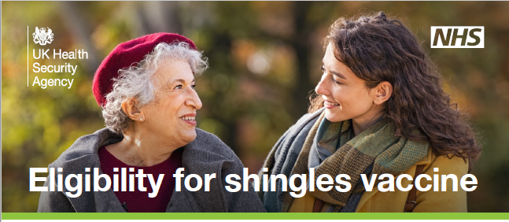
Eligibility for Shingrix vaccine
Further information about the shingles national vaccination programme is available on the GOV.UK website: www.gov.uk/government/collections/shingles-vaccination-programme
This includes an eligibility chart for shingles vaccine by age

Slide 39
Shingrix composition
Composition
  After reconstitution 0.5ml contains:
  Varicella Zoster Virus glycoprotein E antigen^{2,3} 50mcg
  ² adjuvanted with AS01_{B} containing:
  plant extract Quillaja saponaria Molina, fraction 21 (QS-21) 50 mcg
  3-O-desacyl-4'-monophosphoryl lipid A (MPL) from Salmonella Minnesota 50 mcg
  ³ glycoprotein E (gE) produced in Chinese Hamster Ovary cells by recombinant DNA technology
Excipients
  Powder (gE antigen):
  Sucrose
  Polysorbate 80 (E 433)
  Sodium dihydrogen phosphate dihydrate (E 339)
  Dipotassium phosphate (E 340)
  Suspension (AS01_{B} Adjuvant System):
  Dioleoyl phosphatidylcholine (E 322)
  Cholesterol
  Sodium chloride
  Disodium phosphate anhydrous (E 339)
  Potassium dihydrogen phosphate (E 340)
  Water for injections
Notes:
https://www.medicines.org.uk/emc/product/12054

Slide 40
Shingrix contraindications
Contraindications to Shingrix
Systemic allergic reaction (including immediate-onset anaphylaxis) to:
a previous dose of Shingrix vaccine or
any component (excipient) of Shingrix
Notes:
https://www.medicines.org.uk/emc/product/12054

Slide 41
Shingrix co-administration
Shingrix can be given at the same time as inactivated or live vaccines
this now includes the adjuvanted quadrivalent influenza vaccine (aQIV)
previously, a 7-day interval was recommended between Shingrix and aQIV because the potential reactogenicity from two adjuvanted vaccines may reduce tolerability in those being vaccinated
interim data from a US study on co-administration of Shingrix with aQIV is reassuring – there were no safety concerns when the two vaccines were given together
therefore, an appointment for flu vaccination can be an opportunity to also provide shingles vaccine, although shingles vaccine should be offered all year round, rather than purely as a seasonal programme
when Shingrix is given at the same time as the 23-valent pneumococcal polysaccharide vaccine (PPV23), individuals should be advised about possible side effects of fever and shivering
Notes:
Shingrix vaccine can be given at the same time as other inactivated or live vaccines. It was previously advised that there should be a 7 day interval between Shingrix and the adjuvanted quadrivalent influenza vaccine, aQIV. This interval was because there was a concern that there may be potentially be more adverse reactions when these two adjuvanted vaccines are given together. A study looking at co-administration of Shingrix and the adjuvanted flu vaccine has been carried out in the United States. Interim data from this study showed that there were no safety concerns when the two vaccines were given together. Therefore, if a person attends for flu vaccination and they are also eligible for Shingrix vaccine, the two can be given together. However, as shingles is a year round programme, it should not be delayed so it can be given with the seasonal flu vaccine.
Shingrix can also be given with the 23-valent pneumococcal polysaccharide vaccine, PPV23. In studies, when adults aged 50 years and older received PPV23 with their first dose of Shingrix, the immune response to both vaccines was unaffected but fever and shivering were more commonly reported.

Slide 42
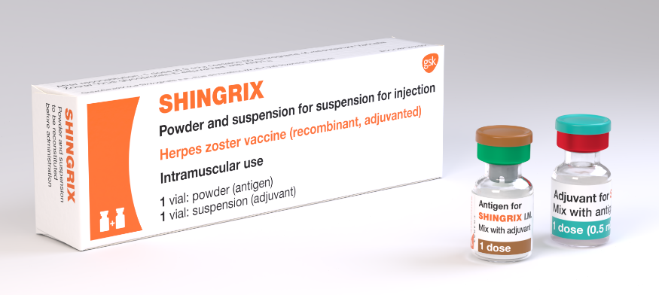
Shingrix dosage and schedule
After reconstitution Shingrix should be administered as a 0.5ml dose.
The schedule consists of 2 doses of vaccine with the following interval between doses:
  8 weeks to 6 months for severely immunosuppressed individuals
  6 months to 12 months for immunocompetent individuals
There is no current recommendation for a booster dose
(the need for booster doses following 2 primary doses has
not yet been determined).
Storage:
Shingrix should be stored in a vaccine refrigerator
at +2ºC to +8ºC.
Notes:
The second dose can be given 8 weeks to 12 months after the first dose but when Shingrix vaccine is being offered to severely immunosuppressed individuals, they should be protected with a full course as soon as possible and so the recommendation is to give the 2nd dose of vaccine at 8 weeks (ideally) to 6 months.
The need for, and the timing of a booster dose, for Shingrix has not yet been determined therefore no booster is currently recommended.

Slide 43
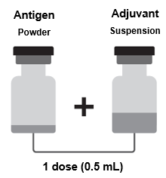
Shingrix reconstitution
One vial contains the powder
One vial contains the suspension (adjuvant)
The powder and the suspension must be reconstituted prior to administration
withdraw the entire contents of the vial containing the suspension into the syringe
add the entire contents of the syringe into the vial containing the powder
shake gently until the powder is completely dissolved (reconstituted vaccine is an opalescent, colourless to pale brownish liquid)
withdraw the entire contents of the vial containing the reconstituted vaccine into the syringe
change the needle so that you are using a new needle to administer the vaccine
if any foreign particulate matter and or variation of appearance is observed vaccine should not be administered
after reconstitution, the vaccine should be used immediately
Notes:
GSK Shingrix including reconstitution instructions: https://gskpro.com/en-gb/products/shingrix/home/

Slide 44
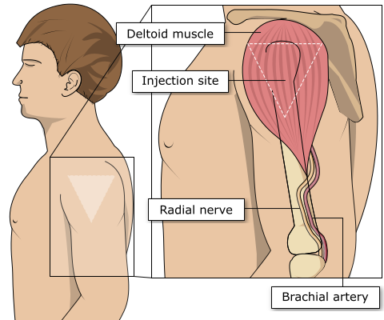
Site of administration
Shingles vaccine should be injected into the deltoid muscle in the upper arm
injecting too high into the upper arm might result in a shoulder injury or a frozen shoulder. This leads to pain, weakness and a limited range of motion that can last for months
injecting too low or too far to the side of the arm risks injecting into the axillary nerve or the radial nerve
to avoid shoulder injury, always assess the limb before administering the vaccine to identify the correct site for injection
Notes:
Shingles vaccine should preferably be injected into the deltoid muscle in the upper arm (or anterolateral aspect of thigh if not possible to use the deltoid muscle).
Injecting too high into the upper arm might result in the vaccine being deposited in the shoulder capsule rather than the deltoid muscle.
This can cause inflammation that can lead to a shoulder injury or a frozen shoulder leading to pain, weakness and a limited range of motion that can last for months.
Injecting too far to the side of the arm or too low on the arm risks injecting into the axillary nerve or the radial nerve.
This can cause a burning or shooting pain during the procedure and can lead to nerve damage (neuropathy/paralysis).
To avoid shoulder injury, the limb should be assessed before administering the vaccine to identify the correct site for injection.

Slide 45
Shingrix possible adverse reactions
Most commonly reported (1:10 of people vaccinated)
Pain, redness, swelling at the injection site;
headache; gastrointestinal symptoms, (nausea, vomiting) lasting 1 to 3 days
myalgia, fatigue, fever
Generally lower in those 70 years of age and above
Less commonly reported (≥1/100 to <1/10)
Injection site pruritus, malaise
Uncommon (≥1/1,000 to <1/100)
Lymphadenopathy, arthralgia
Rare (≥1/10,000 to <1/1,000)
Hypersensitivity reactions including rash, urticaria, angioedema (from spontaneous reporting)
Notes:
A full list of side effects can be found in the Shingrix summary of product characteristics:
https://www.medicines.org.uk/emc/product/12054

Slide 46
Anticipating immunosuppressive therapy
Individuals aged 50 years and older anticipating immunosuppressive therapy:
eligible individuals anticipating immunosuppressive therapy should ideally be assessed for vaccine eligibility before starting treatment
if not previously vaccinated, they should commence a course of Shingrix at the earliest opportunity, at least 14 days before starting immunosuppressive therapy. Leaving one month would be preferable if a delay is possible
Individuals aged 18 to 49 years receiving stem cell transplant:
individuals who have received a stem cell transplant have an increased risk of developing herpes zoster which may have severe and debilitating effects
this risk is elevated regardless of patient age
in recognition of this, it is reasonable to give adult stem cell transplant recipients who are not otherwise eligible 2 doses of Shingrix vaccine as part of their overall treatment plan
see Green Book Shingles Chapter 28a for full details
Notes:
The risk and severity of shingles is considerably higher amongst severely immunosuppressed individuals
Individuals who have received a stem cell transplant have an increased risk of developing herpes zoster which may have severe and debilitating effects
Discussion should take place with the individual patient’s clinical consultant

Slide 47
Current or recent shingles infection
shingles vaccine is not recommended for treatment of shingles or post herpetic neuralgia (PHN)
patients who have 2 or more episodes of shingles in one year should have immunological investigation prior to vaccination
as postherpetic neuralgia (PHN) can persist for many months or years, if the patient is eligible for shingles vaccine by age and they have no other symptoms, then the recommendation would be to offer the Shingrix vaccine without any specific interval before offering vaccine
Notes:
Immunisation of individuals who are acutely unwell should be postponed until they have recovered fully. This is to avoid confusing the diagnosis of any acute illness by wrongly attributing any sign or symptoms to the adverse effects of the vaccine.
Shingrix vaccine can be given as long as the individual has recovered from acute infection and they have no active vesicles

Slide 48
Prescription only medication (POM)
Zostavax and Shingrix should only be administered using a:
prescription written manually or electronically by a registered medical practitioner or other authorised prescriber
patient specific direction (PSD)
patient group direction (PGD)
A PGD template to support the national shingles vaccination programme for eligible adults is available from UKHSA on the GOV.UK website.
Local authorisation is required before PGD templates can be used.

Slide 49
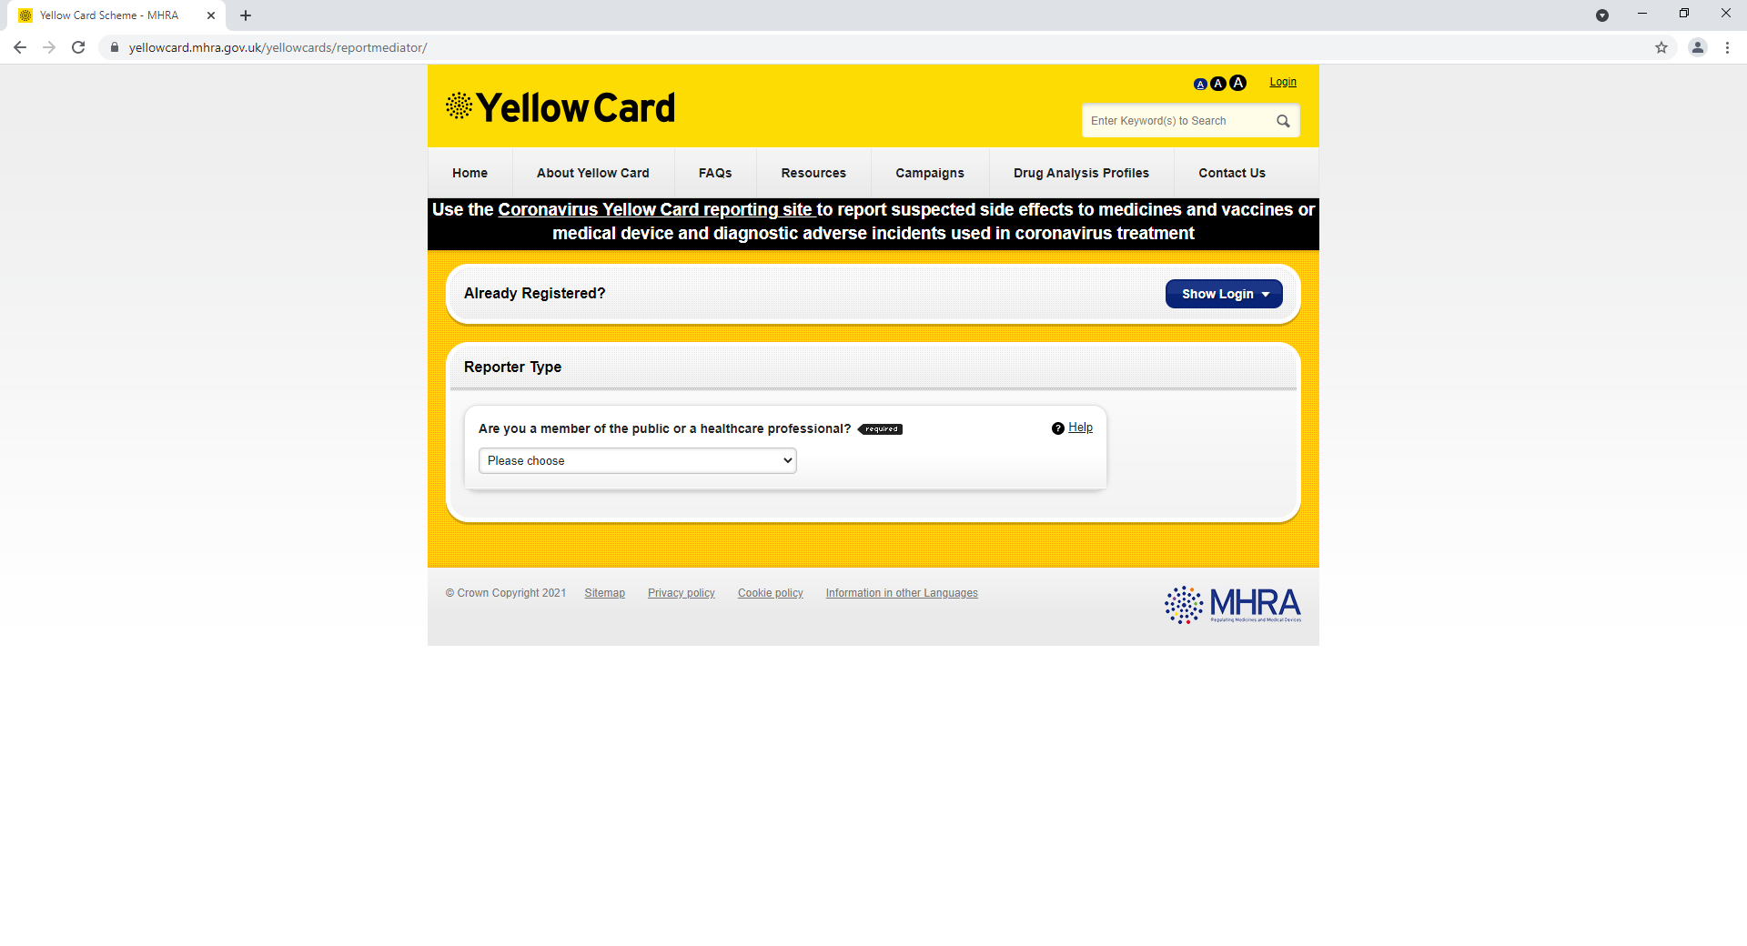
Reporting suspected adverse reactions
    Suspected adverse reactions to Zostavax and Shingrix should be reported to the Medicines and Healthcare products Regulatory Agency (MHRA) using the Yellow Card reporting scheme.
Yellow Card scheme:
voluntary reporting system for suspected adverse reaction to medicines or vaccines
success depends on early, complete and accurate reporting
report even if uncertain about whether vaccine caused condition
reporting site for the Yellow Card scheme: https://yellowcard.mhra.gov.uk/
see the Green Book Chapter 8 for further details
Notes:
Healthcare professionals and patients are encouraged to report suspected adverse reactions to the Medicines and Healthcare products Regulatory Agency (MHRA) using the yellow card reporting scheme.
Yellow Card | Making medicines and medical devices safer (mhra.gov.uk)
https://yellowcard.mhra.gov.uk/

Slide 50
Maximising vaccine coverage
since the introduction of the shingles vaccination programme in 2013 there has been a year-on-year decline in vaccine uptake
efforts to identify and vaccinate all eligible individuals are needed to achieve a continuing reduction in the number of cases of this debilitating and painful condition; if not already in place, a system of call/ recall should be implemented
all those advising on or administering the shingles vaccine should take every opportunity to offer vaccine to eligible patients as soon as they become eligible to help to protect them from this serious illness
Notes:
Refer earlier slide ‘Shingles vaccine coverage data: England’

Slide 51
Key messages
shingles is a severe painful illness, mostly affecting older people, that can persist for several months or even years
the severity of the illness increases with age and those 70 years of age and over are at an increased risk
prior to introduction of the vaccination programme, over 50,000 cases of shingles occurred in people aged 70 years and over each year in England and Wales with approximately 50 cases resulting in death
since 2013, Zostavax has been offered routinely to patients 70 to 79 years of age to reduce the incidence and severity of shingles and shingles related complications
since 2021, Shingrix has been available as an alternative vaccine for eligible patients where Zostavax is clinically contraindicated such as immunosuppression
from 1 September 2023 Shingrix will be available for all severely immunosuppressed individuals from 50 years of age and will also be offered to immunocompetent individuals from 60 years of age in a phased implementation over a 10 year period starting with those turning 65 and 70 years of age
it is important that healthcare professionals offer vaccination to all individuals at the earliest opportunity once they become eligible
Notes:
Severely immunosuppressed individuals (eligibility as defined in the Green Book Shingles Chapter 28a)
Immunocompetent individuals who have not previously received shingles vaccine as part of the routine immunisation programme

Slide 52
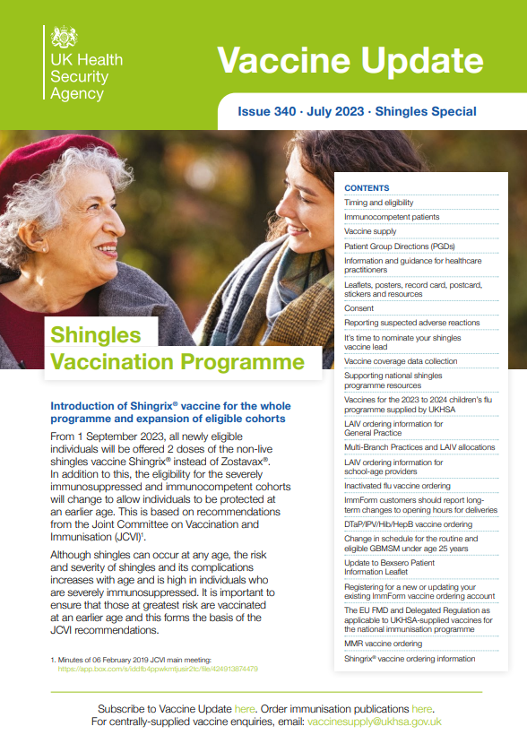
Leaflets and posters
Leaflets, record cards and posters on shingles can be found and ordered through the Health Publications site:
www.healthpublications.gov.uk/Home.html
Vaccine update
This is a monthly newsletter that describes the latest developments in vaccines, vaccination policies and procedures. There is a special edition about the changes to the shingles vaccination programme.
Sign up to receive the newsletter by email:
www.gov.uk/government/collections/vaccine-update

Slide 53
Resources
Resources:
Immunisation against infectious disease (the Green Book) Shingles (herpes zoster) chapter 28a
There will be 2 Green Book Shingles chapters in use prior to 1 September 2023:
  the current chapter (dated 23 August 2021) which contains information about Zostavax. This chapter will be removed once Zostavax is no longer available to order through ImmForm
  the updated chapter (dated 17 July 2023) which includes information about the shingles vaccine programme from 1 September 2023 onwards
Shingles: guidance and vaccination programme
Shingles vaccination: guidance for healthcare practitioners
  This provides additional information about the shingles vaccination programme for healthcare practitioners.
Patient Group Direction templates
Notes:
UKHSA and NHS England Letter Shingles immunisation programme: www.gov.uk/government/publications/shingles-immunisation-programme-letter

